Slide 1
TRADING BOT REQUIREMENTS

Slide 2
USER INPUT VARIABLES
breakout_lines – in contract value (defined every day)
breakout_tolerance – in points
wick_tolerance – in percentage
risk_per_trade – in $
max_candle_body_size – in points
stop_loss_historical_candles – in # of candles (just an int…)
stop_loss_wg_room – in points

Slide 3
PROCESS
TRADING TAKES PLACE ONLY FROM 9:30 am – 10:00 am ET (candle starting at 10:00 am does NOT count)
5 MIN CANDLE CHART
NO TRADES ARE EXECUTED IF BREAKOUT LINES ARE NOT DEFINED!
TRADES ARE EXECUTED ONLY AT END OF EACH CANDLE (5 MIN INTERVALS)

Slide 4
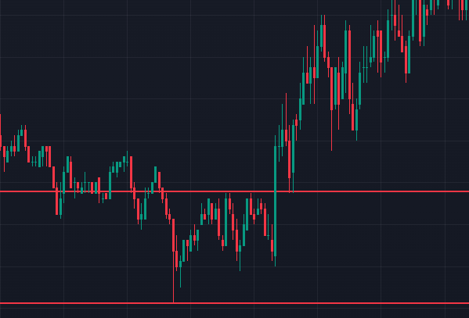
PRICE BREAKOUT
a candle breaks a breakout line => distance (in points) of candle price close is higher than breakout_tolerance
Ex. breakout_tolerance is set to 5 points (defined by user); breakout lines are defined by user (red lines ); candle body size above breakout line = 8 pts.; 8 > 5 => VALID BREAKOUT
8 pts 8 > 5

Slide 5
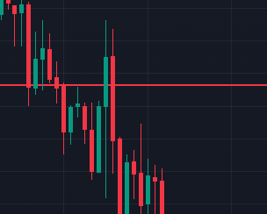
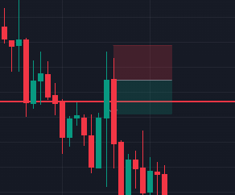
PRICE BREAKOUT
Percentage of a breakout candle wick ABOVE/BELOW a breakout line is smaller than wick_tolerance
In case of a non valid breakout; a trade opposite of candle direction will be executed (green candle => short; red candle => long)
Stop loss is placed ‘stop_loss_wg_room’ amount of points above/below the wick
R:R ratio is 1:1 ex. wick_tolerance is set to 50%; stop_loss_wg_room is set to 3 points; candle size above breakout line = 80 pts.; wick = 45 pts. (56%); body = 35 pts. (44%) => NOT A VALID BREAKOUT => a trade is executed in the opposite direction (see image.); stop loss is placed 3 points above the wick of the latest candle (as per stop_loss_wg_room)
45 pts.
35 pts.

Slide 6
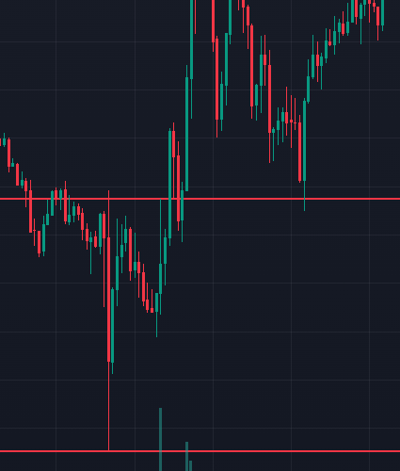
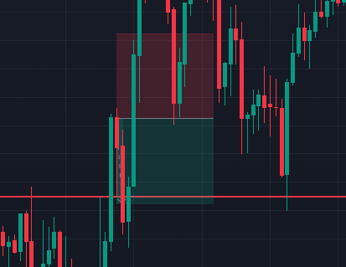
PRICE BREAKOUT
size (opening price to closing price) of a breakout candle is smaller than max_candle_body_size
If a candle breaks a breakout line and it’s body exceeds max_candle_body_size a trade in the opposite direction is executed (green candle => short; red candle => long)
Take profit is set to stop_loss_wg_room amount of points below/above the broken breakout line; R:R = 1
ex. max_candle_body_size is set to 150 points; stop_loss_wg_room is set to 10 points candle size = 176 pts.; 176 > 150 => a trade is placed in the opposite direction of the candle; take profit set to 10 points below breakout line (as per stop_loss_wg_room)
176 pts.

Slide 7
CONTRACT VOLUME
# of contracts is calculated based on risk_per_trade
Actual amount of contracts is rounded to the closest whole number
In practice, actual risk per trade CAN be higher than risk_per_trade
Ex. stop loss is set at 23$ per contract; risk_per_trade is set to 120$. => 120/23 = 5.217 ≈ 5; actual risk = 115$ Ex. Stop loss is set at 23$ per contract; risk_per_trade is set to 155$
=> 155/23 = 6.74 ≈ 7; actual risk = 161$

Slide 8
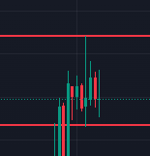
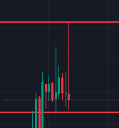
BREAKOUT LINE BEHAVIOR
If a candle’s wick breaks a breakout line and no trades are placed, the breakout line will be moved to the top/bottom of said wick
Breakout line updates take place at 5 minute intervals (when the candle closes..)
No more than 2 breakout lines exist at a time
Ex. breakout lines are set before market open (pic. 1); the following candle breaks the breakout line, but only with it’s wick => the breakout line is moved to the top of the wick

Slide 9
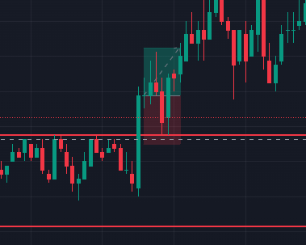
SL & TP
Stop losses (SL) and Take profits (TP) are defined and set by the algorithm
SL is calculated based on a candle whose BODY is closest to a broken breakout line (the whole body has to be within breakout lines…)
Amount of historical candles considered is stop_loss_historical_candles
SL is set by stop_loss_wg_room amount of points above/below candle body
P/L RATIO is 1:1 => TP and SL are the same distance from entry price
Ex. Stop_loss_historical_candles is set to 10; stop_loss_wg_room is set to 1
Closest candle body to breakout line
Candles considered for SL

